Slide 1
what is react flux?
Flux is an application architecture for building user interfaces.
Used with React to manage unidirectional data flow.
Not a library or framework but a pattern.
Use: npm install flux
Note: While installing use --force to bypass the dependency check, because it occurs incompatible error (or) reduce the React, React DOM and testing library using these commands npm install react@17 react-dom@17 npm install @testing-library/react@12

Slide 2
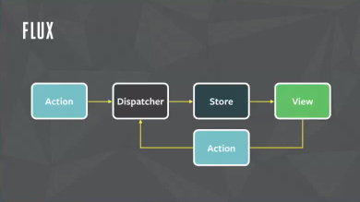

Slide 3
why we use it [and merits]
Flux addresses issues in large-scale React applications:
Complex state management.
Tightly coupled components.
Simplifies:
Debugging with predictable state changes.
State sharing across components.

Slide 4
Advantages of Flux:
Predictable Data Flow: The unidirectional flow makes it easier to understand and debug.
Centralized State Management: Stores provide a single source of truth.
Scalability: The pattern is structured to handle complex applications as they grow.
Improved Performance: Components only re-render when the relevant data in the Store changes.

Slide 5
Components of react flux:
View (React Components):
The UI layer of the application.
Triggers actions based on user interactions (e.g., button clicks).
Listens to changes in the data from the Store and updates the UI accordingly.
Action:
Represents events triggered in the application (e.g., user interactions, API calls).
Dispatches a payload (data object) containing the type of action and relevant data to the Dispatcher.

Slide 6
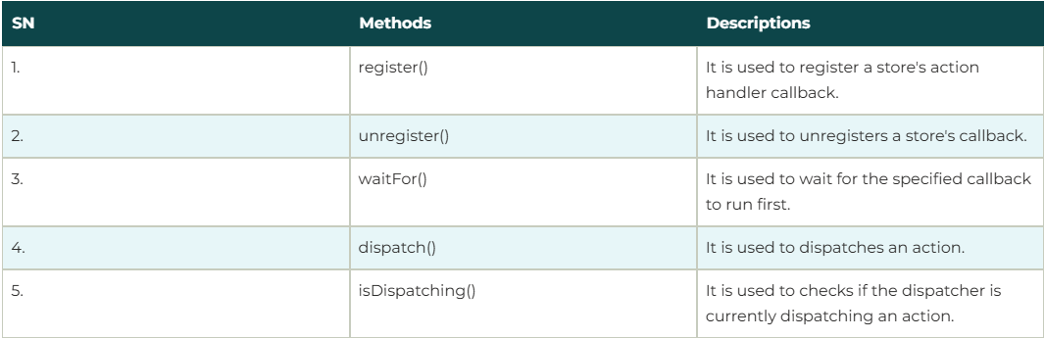
Dispatcher: A singleton that acts as the central hub for all data flow in the app. Receives Actions and forwards them to the Stores. Ensures updates happen in a controlled, sequential manner to avoid cascading issues. Store: Acts as the data layer or the single source of truth for the application state. Stores receive data from the Dispatcher and update their state accordingly. They emit events to notify Views that data has changed. Views never directly modify the store; they only listen for changes and re-render accordingly.

Slide 7
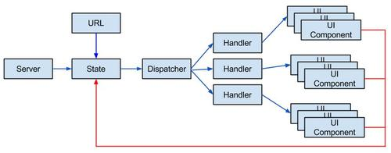

Slide 8
How Flux Works (Data Flow): Flux uses a unidirectional data flow. 1.User Interaction: A user interacts with the View (e.g., clicks a button). 2.Trigger Action: The View triggers an Action. 3.Dispatch Payload: The Dispatcher receives the Action and forwards it to the relevant Stores. 4.Update Store: The Stores process the Action, update their state, and emit a change event. 5.Re-render View: The Views listen to the Store's change event and update themselves with the new state.
example of react flux [how it is done]

Slide 9
Difference in how flux and normal[without flux] works
Feature | Normal Approach | Flux (e.g., Redux)
Data Flow | Bidirectional Hard to trace state changes | Unidirectional
State Management | Spread across | Centralized in a Store
Coupling | components | Loose coupling
Scalability | Tight coupling between components | Easier to manage and scale
State Sharing | Harder in large apps | Global state available to all
Debugging | Requires prop drilling | Easier with tools like Redux Dev Tools

Slide 10
Where do we use it
Managing Complex Application State
Applications with Multiple Data Sources
Maintaining State Across Routes
For applications like chat systems

Slide 11
Is there any limitations to it Limitations
Boilerplate Code: Flux requires more setup compared to simpler state management techniques.
Modern tools like Redux or Zustand offer similar benefits with less overhead.

